Slide 1
Enterprise Apps & Agents
POWER PLATFORM
Enterprise Code App → Dataverse → AI Builder → Copilot Studio Agent → Governed Automation → Capstone Project

Slide 2

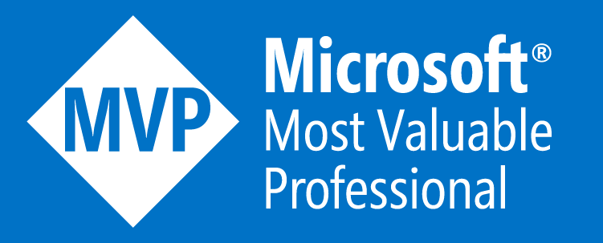
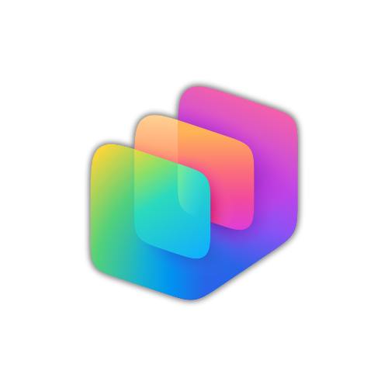



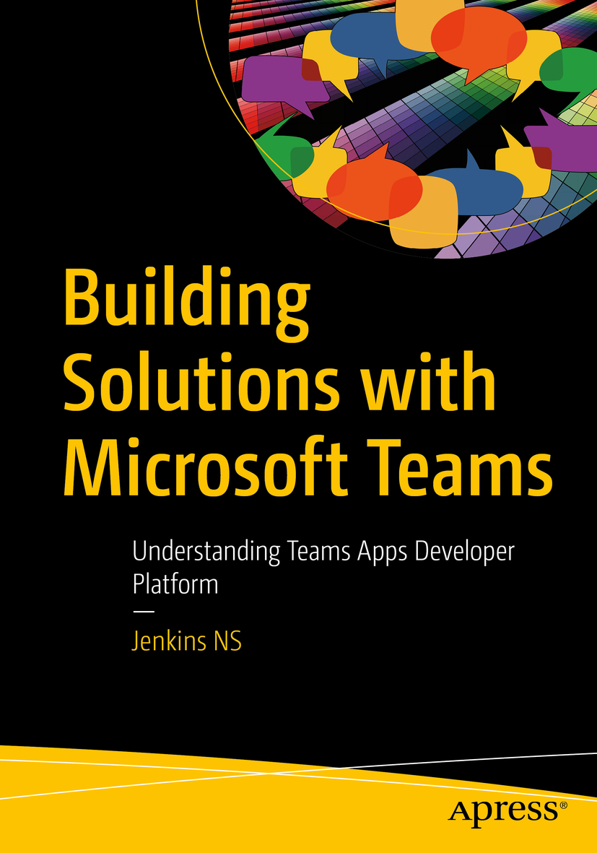
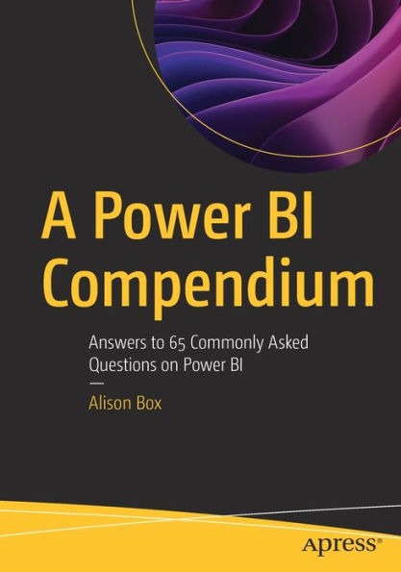


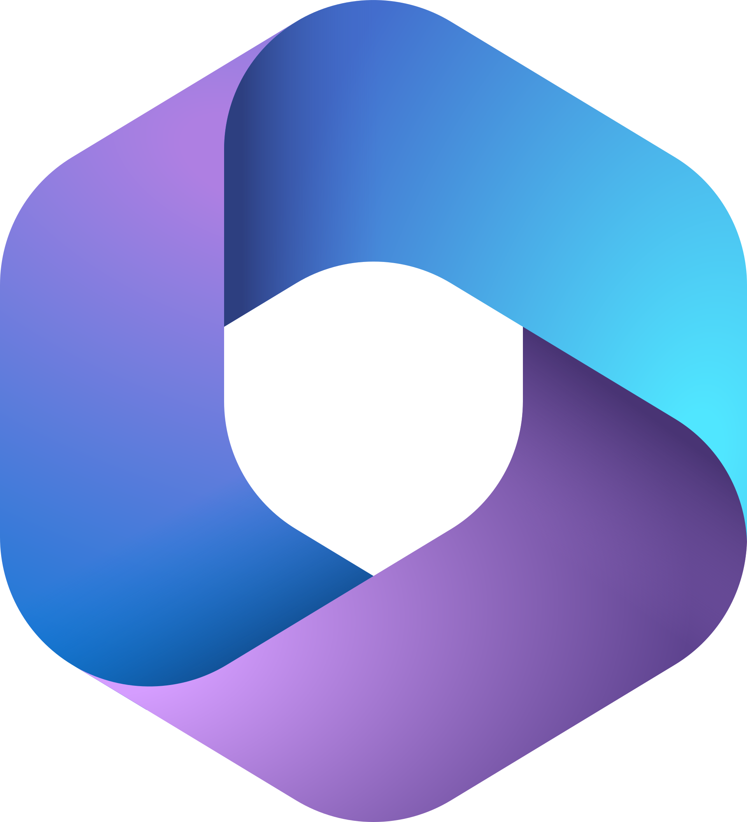
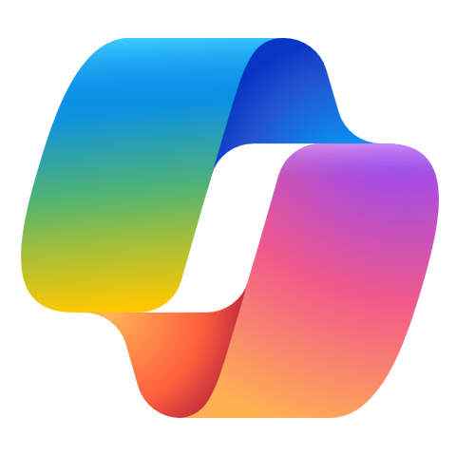




Jenkins NS
Modern Workplace Solution Architect | Consultant
Chennai, India
MVP | MCT | International Speaker | Author | Trainer
Microsoft Ignite Speaker
AI, Copilot, Foundry, Claude, Power Platform, Microsoft 365 and SPFx Specialist
23+ Years of Experience
M365 Bangalore Organizer
Power Platform Chennai Organizer
SharePoint-er Since 2005!
@jenkinsns
https://www.linkedin.com/in/jenkinsns/
https://www.youtube.com/user/jenkinsnss
Author
Reviewer

Slide 3
Let’s get to know each other
Your name
Title/function
Your experience
Your expectations for the course

Slide 4

Notes:
It starts with how they get the most out of their business data
Data is everywhere – generated at every step of our lives
90% of world’s data generated in last 3 years alone
Everything we do, everything our customers do, everything competitors do generates some kind of data
T: In the old world, that data lived in siloes

Slide 5
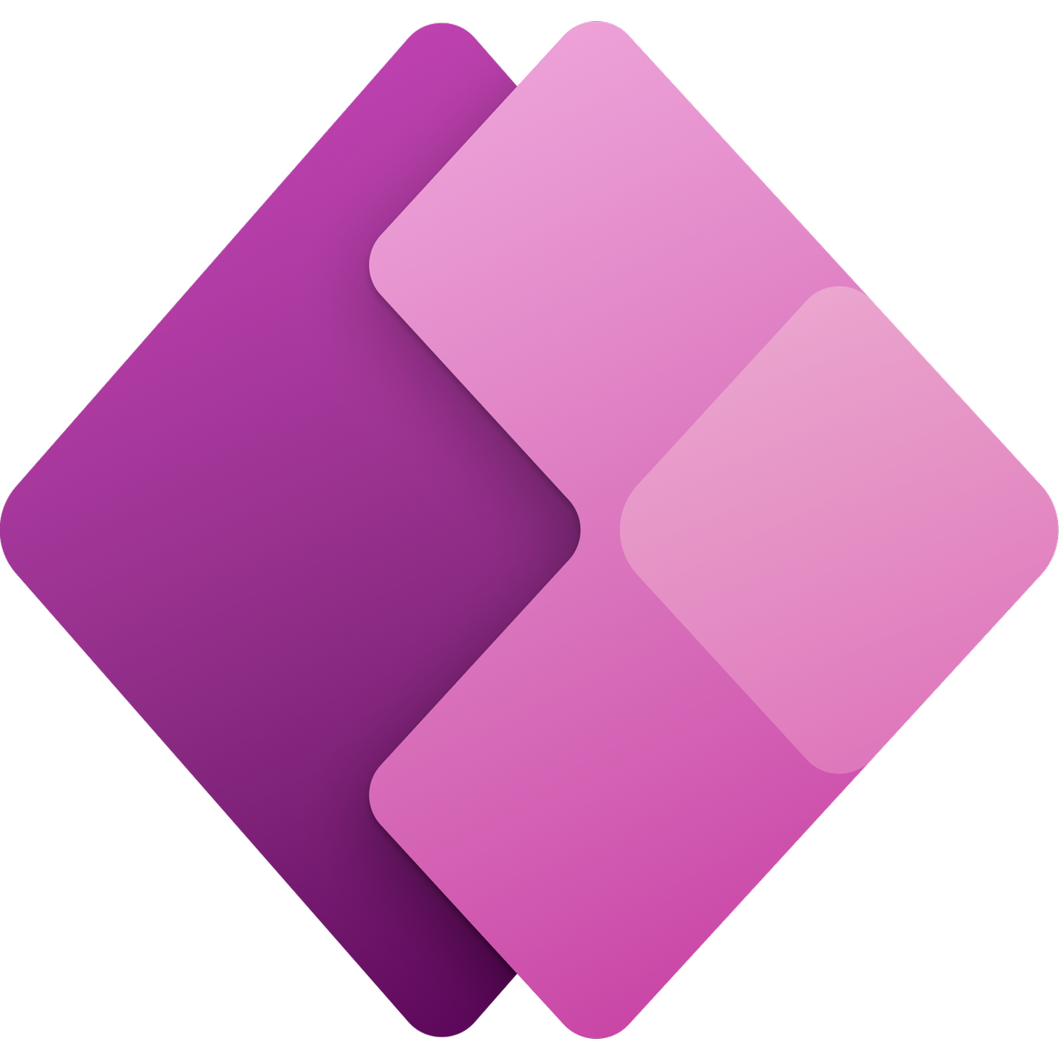

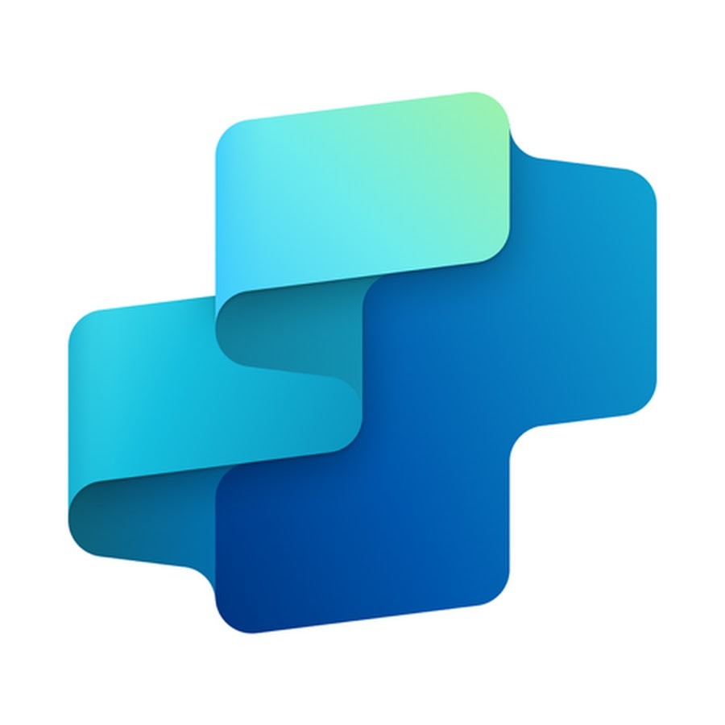
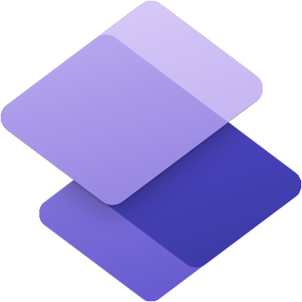



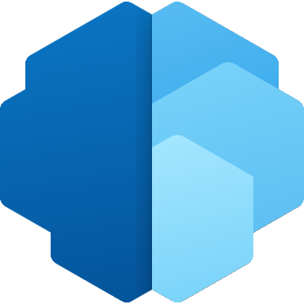

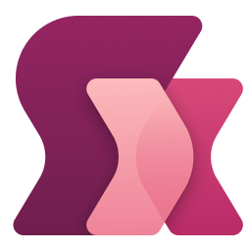

Microsoft Power Platform
Power Apps
Power Automate
Copilot Studio
Power Pages
Power BI
for
web and mobile
application development
for
process
or workflow automation
for
creating and extending copilots
for
building secure,
data-centric business websites
for
data exploration,
analytics and reporting
Data
connectors
AI Builder
Microsoft Dataverse
Power Fx
Managed Environments
Notes:
Power Apps provides a rapid low code development environment for building custom apps for business needs. It has services, connectors, and a scalable data service and app platform (Microsoft Dataverse) to allow simple integration and interaction with existing data. Power Apps enables the creation of web and mobile applications that run on all devices.
Power Automate lets users create automated workflows between applications and services. It helps automate repetitive business processes such as communication, data collections, and decision approvals.
Power BI (Business Intelligence) is a business analytics service that delivers insights for analyzing data. It can share those insights through data visualizations which make up reports and dashboards to enable fast, informed decisions. Power BI scales across an organization, and it has built-in governance and security allowing businesses to focus on using data more than managing it.
Power Pages Construct websites for services like permitting, licensing, grant applications, and outage reporting.
Copilot Studio Enables anyone to create new or extend existing copilots using a guided, no-code graphical interface, without the need for data scientists or developers.

Slide 6
Module 1
Microsoft Power Apps
Code Apps
App.tsx
import { AuthProvider } from './auth';
function App() {
return (
<div className="app-container">
<h1>Power Apps Code App</h1>
<p>Connected with Dataverse</p>
</div>
);
}
export default App;
Bridging Pro-Code with Power Platform
A more developer-centric way to build modern, custom web applications while leveraging the Power Platform ecosystem.
Notes:
🚀 Exploring Microsoft Power Apps Code Apps — Bridging Pro-Code with Power Platform
While exploring the evolving capabilities of Microsoft Power Platform, I recently started learning about Power Apps Code Apps.
What I found interesting is that Code Apps provide a more developer-centric approach where we can use modern web development technologies while still leveraging the Power Platform ecosystem.
💡 How are Code Apps different?
With traditional Power Apps:
🔹 Canvas Apps → Low-code, highly customizable UI
🔹 Model-Driven Apps → Dataverse-driven applications with built-in business capabilities
🔹 Code Apps → More flexibility for developers to build custom web experiences using code
The interesting part is bringing these worlds together.
🧑‍💻 Technologies I'm exploring
• React
• TypeScript / JavaScript
• HTML & CSS
• Power Platform
• Microsoft Dataverse
• REST APIs
• Power Automate
🔗 A simple architecture I’m exploring
Code App
⬇️
Dataverse
⬇️
Power Automate
⬇️
External REST API / Business System
The idea is to use each component where it makes the most sense.
For example:
👉 Code App → Custom UI & user experience
👉 Dataverse → Business data & relationships
👉 Power Automate → Workflow & automation
👉 REST API → Integration with external systems
📌 Real-world scenario
Consider a Service Management application where users need a highly customized interface.
The application could:
• Display customer and asset information from Dataverse
• Provide a custom React-based interface
• Create/update service records in Dataverse
• Trigger Power Automate workflows
• Integrate with an external API for additional information
• Provide custom dashboards and visualizations
This approach can provide the flexibility of modern web development while still utilizing Power Platform capabilities.
🎯 Why I find this interesting as a developer
One thing I'm learning from this is that Power Platform doesn't necessarily mean choosing between low-code and pro-code.
There are scenarios where both can complement each other.
As someone working with Dynamics 365, Dataverse, Power Apps and Power Automate, I'm particularly interested in understanding where Code Apps fit compared with Canvas Apps and Model-Driven Apps — and when each approach makes the most sense.
Still learning and experimenting with it. 🚀

Slide 7
What are Canvas Apps?
Quickly build business applications with a low-code approach.
Key traits
Built with a visual designer
Great for rapid development
Minimal custom code
Ideal for simpler business apps and citizen developers
Connect to Dataverse and many other data sources
Best for
Speed, simplicity and low-code scenarios

Slide 8
Canvas Apps vs Code Apps
Canvas Apps
Code Apps
Quickly build business apps with a low-code approach.
Build modern web apps with pro-code tools.
Visual designer
Great for rapid development
Minimal custom code
Ideal for simpler apps and citizen developers
Connects to Dataverse and many data sources
React, TypeScript, Vue and modern web tools
Full control over UI and architecture
Suits complex logic and reusable components
Power Platform data sources and 1,500+ connectors
Managed authentication, governance and ALM
Best for: speed, simplicity and low-code scenarios
Best for: developer control, complex UI and pro-code scenarios

Slide 9


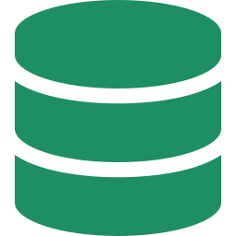

What are Code Apps?
1
Power Apps Code Apps allow developers to build application UI and logic using familiar web development technologies, while still leveraging the Power Platform ecosystem for data, security and business processes.
Familiar web development technologies
Power Platform data
Security and business processes
Notes:
While exploring the evolving capabilities of Microsoft Power Platform, I recently started learning about Power Apps Code Apps.
What I found interesting is that Code Apps provide a more developer-centric approach where we can use modern web development technologies while still leveraging the Power Platform ecosystem.

Slide 10

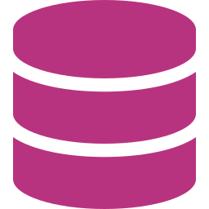
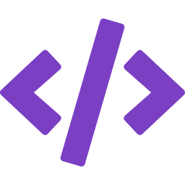
How are they different?
2
Canvas Apps
Model-Driven Apps
Code Apps
OVERVIEW
OVERVIEW
OVERVIEW
Low-code, highly customizable UI
Dataverse-driven with built-in capabilities
Pro-code approach using modern web technologies
BEST FOR
BEST FOR
BEST FOR
Simple to moderate complexity
Data-driven business applications
Highly customized and complex experiences
Notes:
💡 How are Code Apps different?
With traditional Power Apps:
🔹 Canvas Apps → Low-code, highly customizable UI
🔹 Model-Driven Apps → Dataverse-driven applications with built-in business capabilities
🔹 Code Apps → More flexibility for developers to build custom web experiences using code
The interesting part is bringing these worlds together.

Slide 11




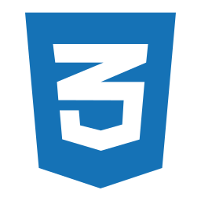

Technologies involved
3
React
TypeScript
JavaScript
HTML
CSS
Power Platform SDK & Libraries
Notes:
🧑‍💻 Technologies I'm exploring
• React
• TypeScript / JavaScript
• HTML & CSS
• Power Platform
• Microsoft Dataverse
• REST APIs
• Power Automate

Slide 12



Architecture flow
4
Power Apps Code App
Microsoft Dataverse
Power Automate
External Systems
Custom UI built with React, TypeScript, etc.
Business data, relationships and security
Automation, approvals and integrations
REST APIs (ERP, third-party services, custom systems, etc.)
CRUD operations via Web API / SDK
Trigger workflows or business logic
Call external services using HTTP actions
Notes:
🔗 A simple architecture I’m exploring
Code App
⬇️
Dataverse
⬇️
Power Automate
⬇️
External REST API / Business System
The idea is to use each component where it makes the most sense.
For example:
👉 Code App → Custom UI & user experience
👉 Dataverse → Business data & relationships
👉 Power Automate → Workflow & automation
👉 REST API → Integration with external systems

Slide 13


Real-world use case
5
Custom React-based UI
Display customer and asset information from Dataverse
Create/update service records
Service Management Application
Trigger Power Automate workflows
Integrate with external REST API (e.g., asset information)
Custom dashboards and visualizations
Notes:
📌 Real-world scenario
Consider a Service Management application where users need a highly customized interface.
The application could:
• Display customer and asset information from Dataverse
• Provide a custom React-based interface
• Create/update service records in Dataverse
• Trigger Power Automate workflows
• Integrate with an external API for additional information
• Provide custom dashboards and visualizations
This approach can provide the flexibility of modern web development while still utilizing Power Platform capabilities.

Slide 14

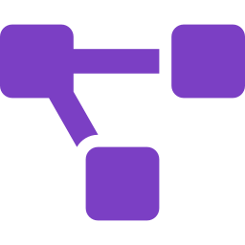

Why developers should explore it
6
Familiar web development stack
Leverages Power Platform ecosystem
More flexibility for custom UI/UX
Easy integration with Dataverse, Power Automate and external APIs
Bridges low-code and pro-code development
Notes:
🎯 Why I find this interesting as a developer
One thing I'm learning from this is that Power Platform doesn't necessarily mean choosing between low-code and pro-code.
There are scenarios where both can complement each other.
As someone working with Dynamics 365, Dataverse, Power Apps and Power Automate, I'm particularly interested in understanding where Code Apps fit compared with Canvas Apps and Model-Driven Apps — and when each approach makes the most sense.
Still learning and experimenting with it. 🚀

Slide 15
Power Apps Code Apps vs PCF
Different Problems. Different Solutions.
Both are powerful. The right choice depends on where you need customization.
Code Apps · Application-level
VS
PCF · Component-level
Notes:
⚔️ Power Apps Code Apps vs PCF — When should you use which?
While exploring Power Apps Code Apps, I came across a question that I think is worth discussing:
If we already have PCF for building custom components, where do Code Apps fit in?
The more I explored both, the more I realized that they aren't really competing technologies. They solve different levels of customization.

Slide 16


Two tools, two levels of customization
Application-level
Component-level
Code Apps
PCF
VS
Build custom business web applications using modern web technologies.
Create custom components to extend Canvas or Model-Driven Apps.
Runs in: Standalone web app (hosted in Power Platform)
Runs in: Within Canvas or Model-Driven Apps
Built with: React, TypeScript, JavaScript, HTML/CSS
Built with: TypeScript, React (PCF framework)
Notes:
🧩 PCF — Power Apps Component Framework
PCF is useful when you want to extend an existing Power App with a custom code component.
For example:
• Custom controls on forms
• Advanced data visualizations
• Custom input experiences
• Reusable components for Canvas or Model-Driven Apps
In simple terms:
“I already have a Power App, but I need a custom component.”
That's where PCF makes a lot of sense.
💻 Code Apps
Code Apps take a different approach.
They allow developers to build custom business web applications using a code-first development approach and modern web technologies, while still leveraging Power Platform capabilities.
For example, Code Apps can be interesting when you need:
• A highly customized application UI
• Complex interactions and navigation
• More control over the frontend
• Integration with Power Platform data and services
• A familiar web development experience using technologies such as React or TypeScript
⚖️ So, how am I looking at it?
Existing Power App + custom component → PCF
Custom application experience + code-first development → Code Apps
The important part is that this isn't really about deciding which technology is “better”.
It's about understanding where the customization is required and what the application needs to achieve.

Slide 17



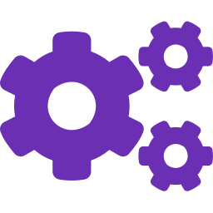
Code Apps: build the whole application
Full custom business web apps using modern web technologies.
Example: Service Management app
125
28
342
Total Work Orders
Open Issues
Active Assets
Technologies
React
TypeScript
JavaScript
HTML
CSS
Power Platform SDK & APIs

Slide 18






PCF: extend what you already have
Custom components that extend Canvas or Model-Driven Apps.
Example: Equipment form in a Model-Driven App
Location (custom PCF control)
Name | Excavator EX-200
Equipment Type | Heavy Machinery
Serial Number | EX2000-4587
Status | Active
Customer | ABC Construction
Latitude 28.6139
Longitude 77.2090
Rendered by a custom component inside the form, not a new app.
Common PCF use cases
Custom Controls
Data Visualizations
Custom Input Components
Reusable Components
Extend Canvas or Model-Driven Apps

Slide 19
Key differences at a glance
Aspect | Code Apps | PCF
Scope | Application level | Component level
Runs in | Standalone web app (hosted in Power Platform) | Within Canvas or Model-Driven Apps
Technologies | React, TypeScript, JavaScript, HTML/CSS | TypeScript, React (PCF framework)
Main use case | Custom application experience | Custom components inside existing apps
Best for | Highly customized and complex scenarios | Extending existing Power Apps functionality

Slide 20



When to use which
When to use Code Apps?
When to use PCF?
You need a full custom application experience
You need a custom component inside a Power App
Complex UI/UX requirements
Custom controls on forms
Custom navigation and rich interactions
Advanced data visualization
Integration with multiple APIs and services
Custom input experiences
More control over the frontend using modern web stack
Reusable components
Extend existing Canvas or Model-Driven Apps

Slide 21
Choose by where you need customization
Need a whole custom application?
Need a better piece inside an existing app?
Code Apps
PCF
Application-level
Component-level
Complex UI/UX, custom navigation, multiple APIs, full control of the frontend.
Custom controls, data visualizations and reusable components for Canvas or Model-Driven Apps.
Different problems. Different solutions. Both are powerful.

Slide 22
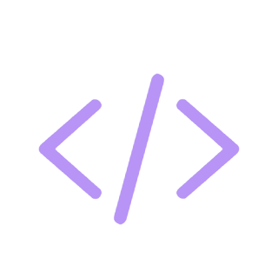
Build Code Apps
POWER PLATFORM
Prerequisites and Quick Start: Build, Run, and Deploy Your App from Scratch
Notes:
Welcome. This deck walks through what you need before building your first Power Apps Code App, then the six commands that take you from a starter template to a deployed app.

Slide 23



Build full apps with React and JavaScript, then deploy them to Power Platform.
WHAT CODE APPS ARE
Build
Run
Deploy
Full apps using React + JavaScript, starting from the Vite template.
Test on your own machine with npm run dev before you ship.
Build, then push to Power Platform with pac code push.
Notes:
Code Apps let you build full apps with React and JavaScript and deploy them to Power Platform. The workflow is simple: build, run locally, deploy.

Slide 24

Prerequisites
BEFORE YOU START
Before you build your first Power Apps Code App, make sure you have:
Node.js (LTS version)
Visual Studio Code
Git
Power Platform CLI (PAC CLI)
A Power Platform environment with Code Apps enabled by your Power Platform Admin
Notes:
Five things to have in place: Node.js LTS, Visual Studio Code, Git, the Power Platform CLI, and an environment where your admin has enabled Code Apps. The next slide shows where the admin turns that on.

Slide 25
Enable Code Apps in your environment
ENVIRONMENT SETUP
Your Power Platform Admin turns this on in the admin center:
Power Platform Admin Center
Environment
Settings
Features
Enable Power Apps Code Apps
Notes:
This is an admin task. In the Power Platform Admin Center, open your environment, go to Settings, then Features, and enable Power Apps Code Apps. If you are not the admin, send them this path.

Slide 26
Clone, then authenticate
GETTING STARTED · STEPS 1–2
1
Clone the starter template
Then open the folder
npx degit github:microsoft/PowerAppsCodeApps/templates/vite my-app
cd my-app
2
Authenticate to Power Platform
Sign in and select your environment
pac auth create
pac env select --environment <environment-id>
Notes:
Step 1: use degit to copy the Vite starter template into a folder called my-app, then move into it. Step 2: sign in with pac auth create and pick your environment by its ID with pac env select.

Slide 27
Install, then initialize
GETTING STARTED · STEPS 3–4
3
Install dependencies
Installs the project packages
npm install
4
Initialize the Code App
Creates and initializes your Code App
pac code init --displayname "My First Code App"
Notes:
Step 3: npm install pulls in the project dependencies. Step 4: pac code init creates the Code App in Power Platform and gives it a display name. Swap in your own app name.

Slide 28
Run locally, then deploy
GETTING STARTED · STEPS 5–6
5
Run locally
Run the app on your machine
npm run dev
6
Build and deploy
Build the app, then deploy it to Power Platform
npm run build
pac code push
Notes:
Step 5: npm run dev starts the app locally so you can try it. Step 6: npm run build creates the production build and pac code push deploys it to Power Platform.

Slide 29
Demo
POWER PLATFORM
H1. Banking: scaffold and run a Code App locally
H2. Insurance: map a claims-servicing scenario to the appropriate app model
H3. Supply Chain: produce a shipment-tracking app specification and data contract
Notes:
Welcome. This deck walks through what you need before building your first Power Apps Code App, then the six commands that take you from a starter template to a deployed app.

Slide 30
Closing slide
Thank you

